Slide 1
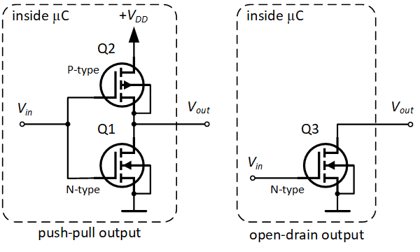
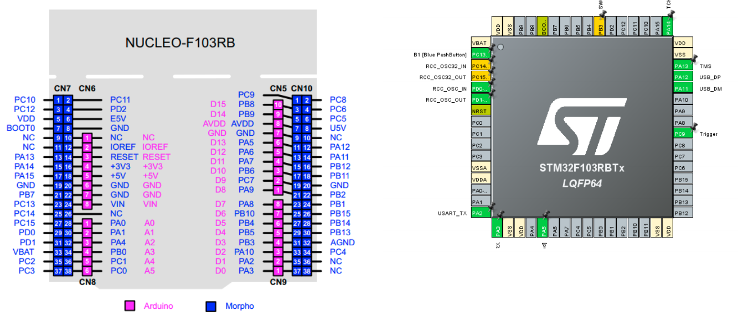
Microcontroller GPIO

Slide 2
Content
GPIO Output Mode
GPIO Input Mode
Analog Mode
Alternative function Mode

Slide 3
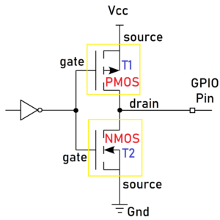
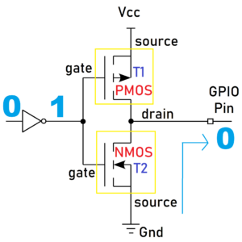
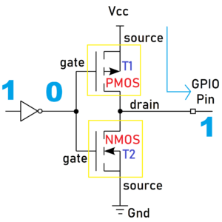
GPIO Output
T1 is the PMOS
and T2 is the NMOS.
When we write 1 from our code, the first inverter will make it as 0
T1 will be activated and T2 will be deactivated
T1 will take the Vcc and give it to the GPIO pin
Ouput HIGH
Output Low

Slide 4
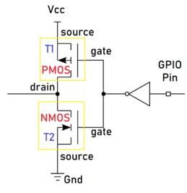
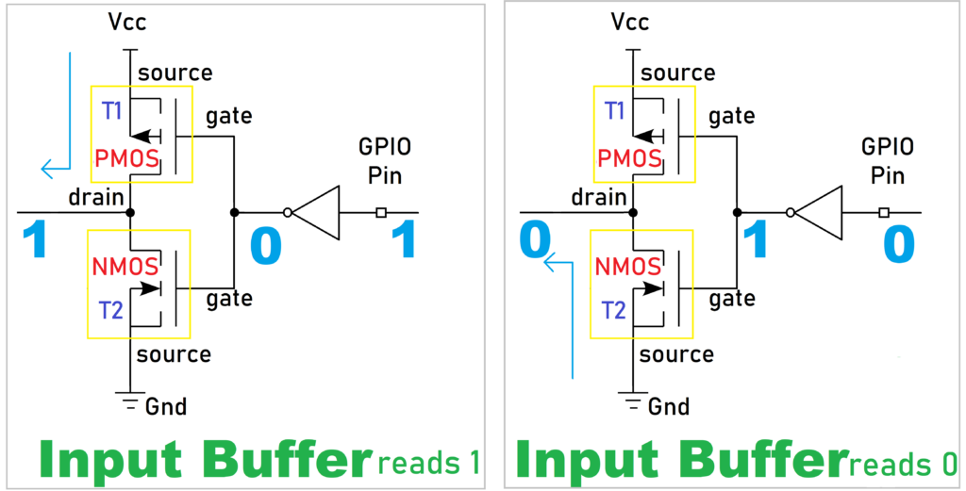
GPIO Input
When input GPIO = 1, the inverter makes it as 0
PMOS T1 is activated and the NMOS T2 is deactivated
T1 will take the Vcc and give it to the processor 🡪 get 1 in the software program
Opposite behaviors occur when GPIO pin = 0

Slide 5
GPIO Input Modes
High-impedance or Floating
Pull-up
Pull-down

Slide 6
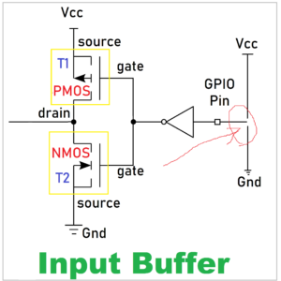
High-impedance
Whenever the microcontroller is powered ON, the GPIO pins are by default in this HIGH impedance state input mode.
High-impedance or HI-Z State of a GPIO is the state when a pin is floating by not connecting to either HIGH (VCC) or LOW (GND) Voltage levels.
Its state is indeterminate (cannot determine the logic level, which is 0 or 1) unless it is driven high or low externally.
Floating state can lead to leakage current, which may result in high power consumption because a floating pin is highly susceptible to picking up the noise and may result in leakage current.
🡪 It is recommended to keep the unused pins in either a pull-up or pull-down state to avoid leakage of current.

Slide 7
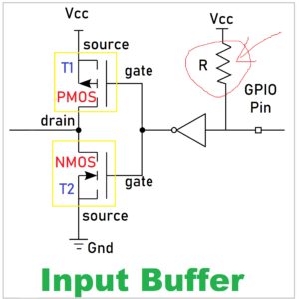
Pull Up
The internal pull-up resistor is connected to the pin. So, the state will be HIGH unless an external pull-down resistor is used.
There will be a particular register to enable this pull-up resistor in the microcontroller (check on the datasheet)

Slide 8
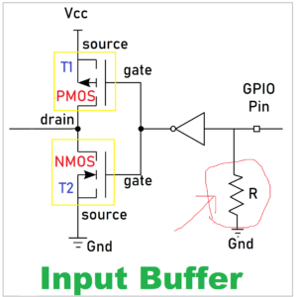
Pull Down
In this type, the internal pull-down resistor is connected to the pin. So, the state will be Low unless an external pull-up resistor is used.
There will be a particular register to enable this pull-down resistor in the microcontroller.

Slide 9
GPIO Output Modes
The GPIO is used to drive the electrical signal (high or low) to the pin when it is configured as a output. There are primarily two configuration options for GPIO outputs:
Push-pull
Open-drain

Slide 10
Push-pull
This state is the default state of the GPIO output mode. The pin can “push” the signal high or “pull” it low using the PMOS transistor or NMOS transistor.
There is no need for pull-up or pull-down resistors as the PMOS and NMOS transistors do that job.

Slide 11
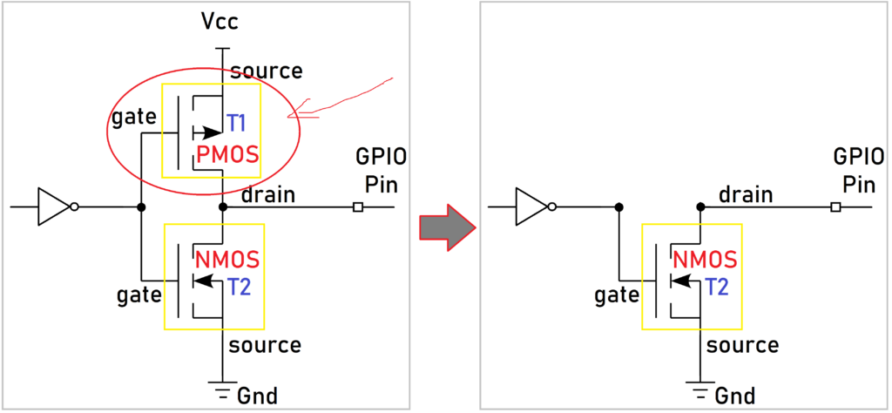
Open-Drain
In GPIO output mode, the output buffer is formed using the PMOS and NMOS transistors. If you remove the PMOS transistor, then it will be an open drain output mode.
The name comes from the fact that the MOSFET’s drain isn’t internally connected to anything. If you use BJT instead of MOSFET, then this is called an Open collector
When you make the NMOS to high, then it will supply a GND. The GPIO pin will be Low.
When you turn off the NMOS, the GPIO will not be connected to either Vcc or GND. It will be in a floating state. So, the output will be either Low or high impedance (floating). It can pull the pin towards the ground, but it cannot drive it high.
Open drain outputs are most commonly used in communication interfaces where multiple devices are connected on the same line (e.g. I2C, One-Wire, etc.). When all of the outputs of the devices connected to the line are in the Hi-Z state, the line is driven to a default logic 1 level by a pull-up. Any device can pull the line to logic 0 using its open drain ouput and all devices can see this level.

Slide 12
Analog Mode
This mode connects the pin to an internal ADC (analog-to-digital converter) and allows you to read a value that represents a given voltage in a pin.
The value depends on the resolution of the ADC, for example, a 12-bit ADC can have values that go from 0 to 4095.
This value is mapped to a voltage that is between 0V and (usually) the voltage the microcontroller is running (3.3V for example).
When a GPIO is configured in analog mode the input pull-up/pull-down resistors are disconnected (floating).

Slide 13
Alternate Function Mode
GPIO pins have the capability of providing an alternate function apart from the regular three modes.
The pins are multiplexed to provide functionalities: UART Rx/Tx pins, I2C pins, etc.
There will be a separate register to set the alternate functions.

Slide 14
LED BLINKY on STM32CUBE IDE
[STM32CubeIDE] https://www.youtube.com/watch?v=ZuBKAAFxjgk
[Proteus Simulation]
https://www.youtube.com/watch?v=b5K0uxedVDw

Slide 15
Software Timer

